Slide 1

Everything Everywhere All At Once
Alexander Kraemling, Arnav Sacheti, Jan Pilja, Shawn Greenwood

Slide 2

Everything
Evelyn and Waymond owe taxes, and their marriage and business is falling apart
Joy attempts to introduce her girlfriend to the family
Evelyn is a failure in life
Notes:
Shawn
Movie is split into 3 sections, e,e,aao
Evelyn and waymond middle aged couple, 1 daughter, chinese immigrants who moved to open laundromat
Buisness is ok, but taxes are screwed up and evelyn uncovers divorce papers under the tax papers
Evelyn father visiting from china, joy tries to introduce gf but evelyn hijacks conversation and introduces her as friend
Evelyn is at rock bottom, and is the worst version of herself through all verses

Slide 3

First Verse Jump
Evelyn is introduced to the existence of the infinite multiverse
She gains the ability to ‘verse-jump’ and inhabit alternate versions of herself
Must perform an unusual act to verse jump
Can access the skills and memories from other Evelyns
Through this she can change her capabilities
Notes:
JAN
This scene establishes the core sci-fi premise of the film
Evelyn's first exposure to the strange "verse jumping" technology
Sets up how she can transcend limits of her current self/reality
Foreshadows the profound identity crises this ability will trigger

Slide 4


Hot Dog Hands
Performing the wrong action can result in strange results
Evolutionary branch that results in hot dog hands
Notes:
Verse jumping isnt always sunshine and roses
Performing wrong action can result in connecting to strange universes
Hot dog hand universe, people play piano w their feet, two people really love eachother they get the condiments out, something or other

Slide 5


The Alpha-Verse
Regular Waymond
All-knowing, all-powerful authority over reality-jumping
Unlimited surveillance
Track infinite ‘lifepaths’
Centralized power with lack of transparency/oversight
The original multiverse, all multiverses split off of this one
Alpha Waymond
Notes:
Jan

Slide 6

Jobu Tupaki
Jobu Tupaki is the main antagonist of the film
Mind permanently fractured after being pushed too hard to travel multiverses
Motives are unclear beyond a drive for total universal destruction
Can manipulate reality to her will
Personifies nihilism in the face of all the universes possibilities
Notes:
Alexander

Slide 7

Notes:
JAN
Evelyn and the viewer are introduced to the everything bagel
Creation of Jobu Tupaki
The bagel is a symbolic centerpiece loaded with metaphysical significance
It embodies the film's exploration of finding meaning in the overwhelmingly infinite
Evelyn's journey to accept the bagel's chaotic everything-ness is pivotal
Everything that has existed, currently exists, and will ever exist is in the bagel

Slide 8


Everywhere
Evelyn jumps through multiverse after multiverse, confronting her alternate possibilities
Evelyn tries to make things right with Jobu
They’re rocks for a little while
Notes:
Evelyn gains skills from many universes to fight jobu tupaki or at least understand her
She tries to understand why her daughter wants to leave it all behind
This leads to them becoming rocks in a universe where no life has evolved at all

Slide 9

All at Once
Evelyn tries to make things right with Jobu Tupaki and Waymond
While things don't fully resolve, they commit to getting through the challenges together
Evelyn and Waymond Kiss
Tax audit goes better
Notes:
Evelyn is fully committed to mending her relationship with jobu and waymond
She meets waymond in other universes to understand him better
Big fight to try and stop jobu from entering the bagel
This doesn’t fix everything, but she agrees to not enter the bagel
Tax lady agrees to give her a break
Evelyn and waymond kiss and agree to try and work things out, evelyn and joy agree to work their feelings out too
End of movie

Slide 10
Writers Intention [3]
They used the verse jumping device as the key element.
Technology wasn't the writer's primary focus.
Technology’s use served to emphasize a fundamental theme: the tension between maintaining control through technology and surrendering to the unpredictable nature of existence.
The story delves deep into the human struggle with control.
The story presents the profound choice between holding onto what's familiar or embracing the uncertainty of the unknown.
Notes:
ALEXANDER
The writers did not have a primary focus on technology while creating this movie. Instead, they confronted the human struggle for control, and tried to find meaning in an otherwise meaningless universe with ultimate possibilities. To achieve this, they used the technology of verse jumping to demonstrate the tension between maintaining control and surrendering to the unpredictable nature of existence. Technology is only a tool to get this theme across.

Slide 11
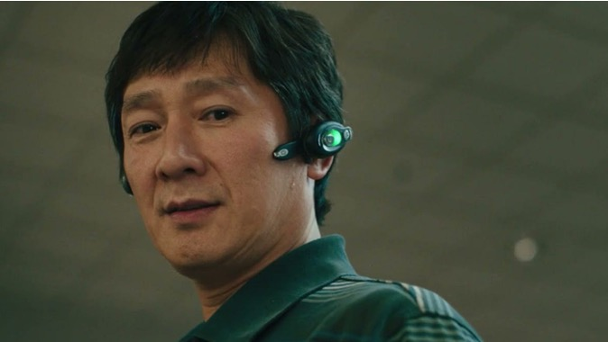

Computing Technology
Verse Jumping Device
Allows user to temporarily link conscious to another version of yourself
Only able to use when performing a weird act
Notes:
Jan
0:34:55 - “In your search to prove the existence of other universes, you discovered a way to temporarily link your conscious to another version of yourself, accessing all of their memories, their skills, even their emotions” - Alpha Waymond

Slide 12
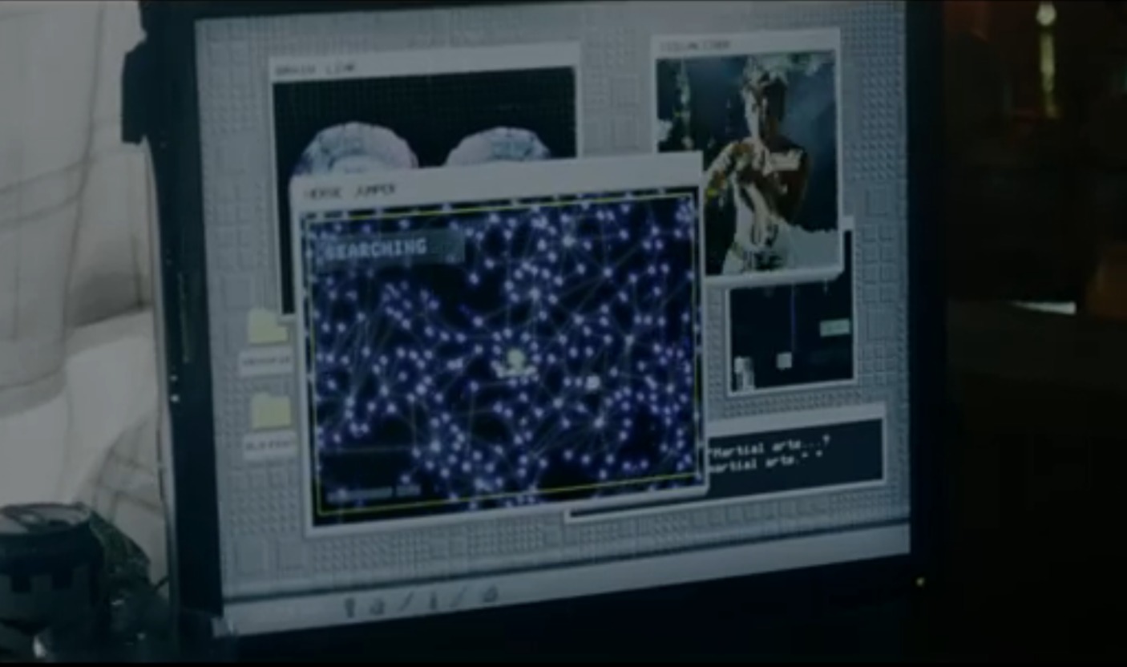
Computing Technology
Life Path Visualizer
Shows all the decisions a person has made in their life
Helps Jumpers identify what action will get them
to another universe
Notes:
Arnav
This is the lifepath map, it shows you all the different decisions you made and how they fractured off into different universes. The alphaverse has a tool that allows you to identify an action that creates a ‘slingshot’ that will launch you into a different verse; connecting your conscious.

Slide 13
Verse Jumping vs Privacy
Potential Issues:
Unregulated surveillance capabilities
Alphaverse maps identities of every individual across the multiverse without consent
Ability to track ‘lifepaths’ and all potential decisions/actions raises major privacy concerns
Centralized Control & Transparency Issues
No oversight or transparency around Alphaverse’s control of the technology
Mirrors real-world debated around reining in unregulated surveillance overreach by organizations
Notes:
Jan

Slide 14
Governance and Policy
Risks of Reality Manipulation and verse jumping
Verse jumping headsets allow influencing decisions across universes with no checks
Potential for abuse and unrestrained alterations if left ungoverned
Need for Public Policy
Updated legal frameworks to regulate emerging technologies that can infringe on privacy
Safeguards and transparency are essential before reality-bending abilities start to overreach
Notes:
ALEXANDER KRAEMLING
There are several risks involved in reality manipulation and verse jumping. For one, reality manipulation can easily be abused and is abused by Jobu Tupaki, who goes from multiverse to multiverse, destroying things with no checks on her power. Verse jumping also allows users to escape from any realities consequences to a new reality, and cause trouble there. There is no governance on the actions of these jumpers, causing significant problems. This results in a need for policy, and updated legal frameworks to regulate emerging technologies that can infringe on privacy.
In the case of new emerging and pivotal technologies such as these, safeguards and transparency are essential to avoid overreach by those in control of those technologies.

Slide 15

Information Overload
Splitting your mind over multiple facets can lead to information overload.
This is seen at the end of Everything when Evelyn's mind becomes fractured
Notes:
Arnav
Social Media is often linked to having similar aspects of information overload, allowing individuals to connect virtually> However, many associate the site as showing what they could be, similar to how Evelyn would seemingly get lost in other universes.The dangers of social media have often come into scrutiny and are subject to many studies, with one finding “using between 7 and 11 different social media platforms compared to respondents using only 2 or fewer platforms” had a “3 times greater odds of having high levels of depressive symptoms and a 3.2 times greater odds of having high levels of anxiety symptoms” [2].

Slide 16
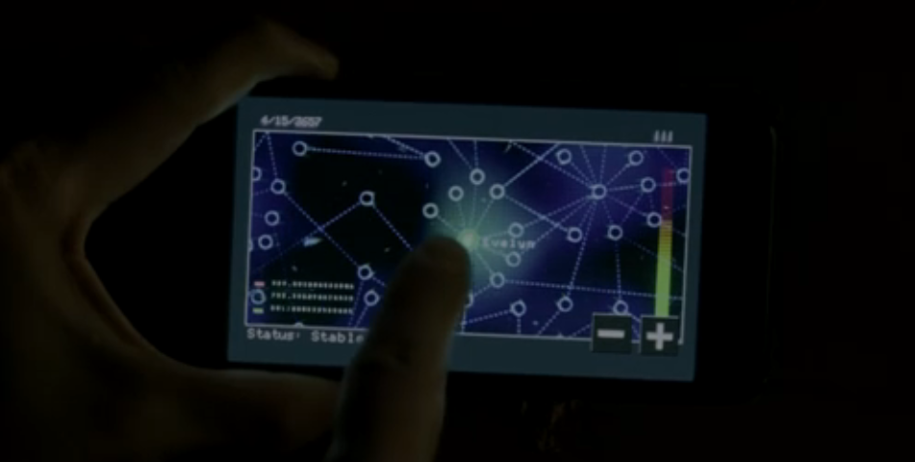
Private Data
The Alphaverse has access to the lifepath data of all its inhabitants, and the spread of this information is controlled.
Notes:
Arnav
The lifepath tool tracks a lot of personal/private data about someone, showing all the different versions that someone could be; some good, some bad. This tool opens up the possibility that the Alphaverse may choose to use this tool for their goal, potentially interfering with other universes, without any reasoning other than it is our mission.
When people are jumped to, they are not aware of what is happening.

Slide 17
Key Conclusions
Your right to privacy is unprotected not only from others, but also from yourself (in the case of a multiverse traveler using your body)
Legislation is necessary for emerging technologies with unlimited and vast capabilities (such as Verse Jumping)
The mind is sensitive to information and too much of it can lead to negative mental effects
Data that is private should remain private. Technologies that greatly interfere with the privacy of others can lead to significant, uncontrollable damages.
Notes:
Alexander

Slide 18
THE END

Slide 19
Going Into Our Conclusions
The metaphysical “verse-jumping” premise explores:
Issues surrounding privacy rights and autonomy over personal identity
Need for public policies governing reality-altering technologies
Tension between humanity’s pursuit of control and acceptance of uncertainty
Notes:
While not the focus, the core concept inevitably raises these philosophical issues
Questions autonomy when minds/memories can be overwritten across realities
Parallels current privacy debates around emerging tech capabilities
Overarching theme of needing to embrace the unknown versus desire for order
Character arcs confront struggle of when to exert control versus "let go"

Slide 20
References - ?
[1] Bond, S., & Bridges, L. (2023, March 31). Column | Simultaneously loving and hating “Everything Everywhere All at Once.” The Daily Illini. https://dailyillini.com/buzz-stories/2023/03/31/everything-everywhere-all-at-once-review/
[2] Naslund, J. A., Bondre, A., Torous, J., & Aschbrenner, K. A. (2020). Social Media and Mental Health: Benefits, Risks, and Opportunities for Research and Practice. Journal of technology in behavioral science, 5(3), 245–257. https://doi.org/10.1007/s41347-020-00134-x
[3] Pasternack, A. (2022, April 7). How the Daniels figured out “Everything Everywhere All at Once.” Fast Company. https://www.fastcompany.com/90738552/everything-everywhere-all-at-once-multiverse-internet
Notes:
[2] - APA cited

